Slide 1
Variational Autoencoders Theory and Extensions
Xiao Yang
Deep learning Journal Club
March 29

Slide 2
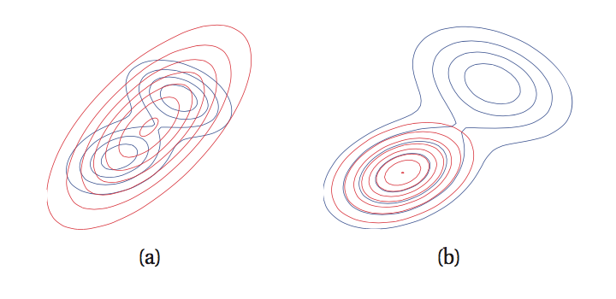
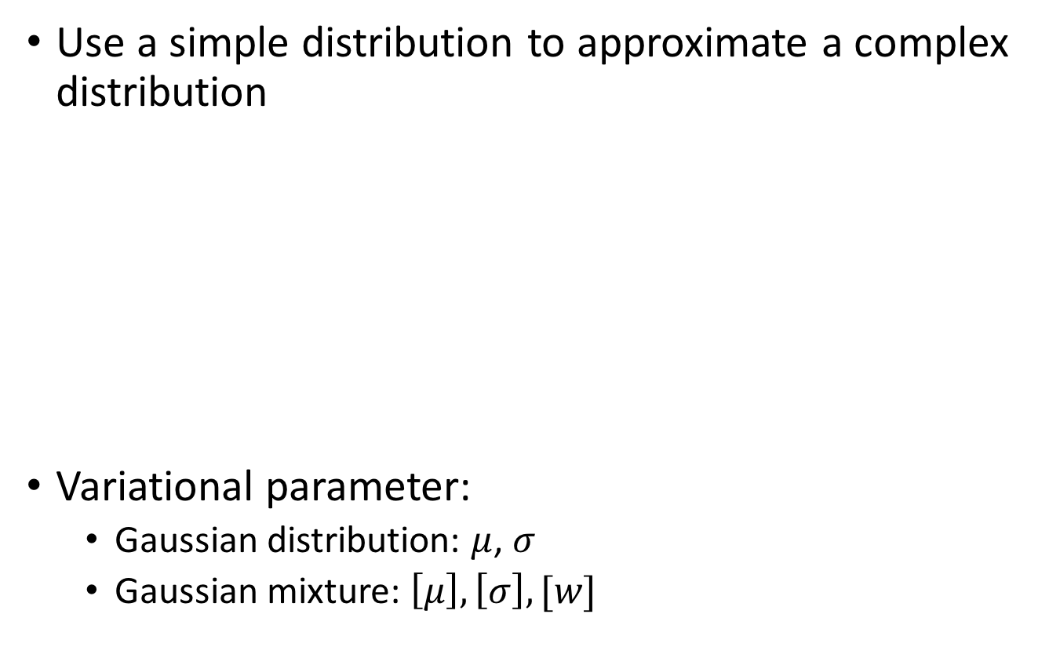
Variational Inference
Use a simple distribution to approximate a complex distribution
Variational parameter:
Gaussian distribution: $μ$, $σ$
Gaussian mixture: $\left[μ\right], \left[σ\right], [w]$

Slide 3
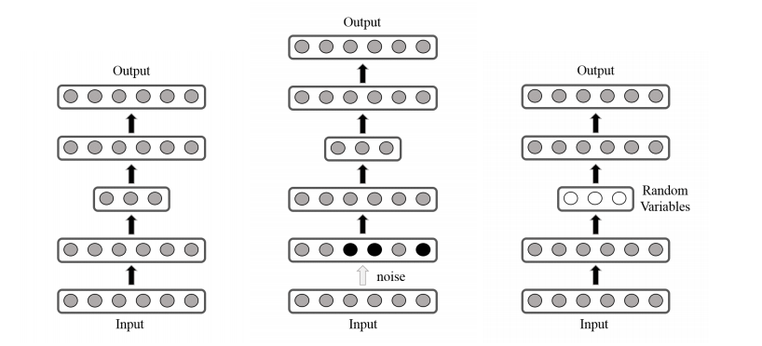
Autoencoder
basic
denoising
variational
http://www.cs.unc.edu/~eunbyung/papers/manifold_variational.pdf

Slide 4
Why Variational Autoencoder…
when we have Boltzmann Machine?
Directed models are more useful these days
Cannot build recurrent model using Boltzmann Machine
Need to be deep, but does not help too much
when we have denoising autoencoder?*
Mathematically reasonable, but the result is meh.
Need to manually tune hyperparameters, and not very representative
*Generalized Denoising Auto-Encoders as Generative Models, Yoshua Bengio, et al., NIPS 2013

Slide 5
Variational Autoencoders
Auto-Encoding Variational Bayes, Diederik P. Kingma, Max Welling, ICLR 2014

Slide 6
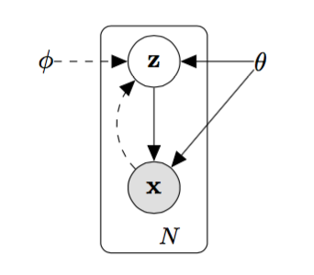
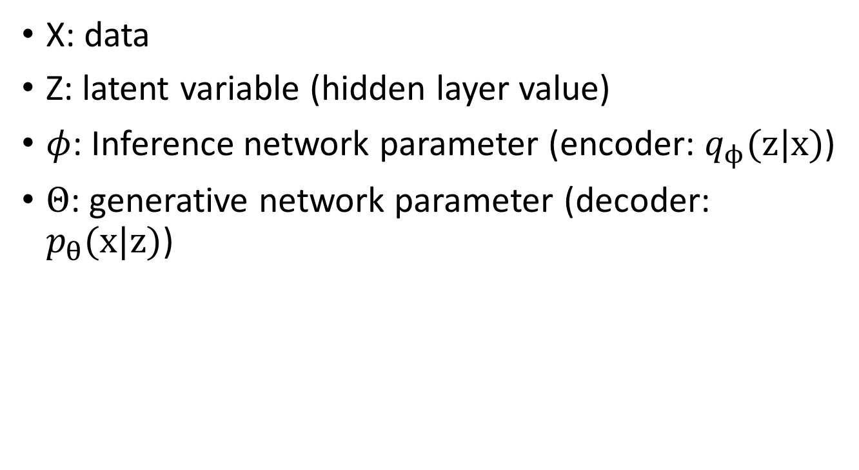
Theory: Variational Inference
X: data
Z: latent variable (hidden layer value)
$φ$: Inference network parameter (encoder: $q_{ϕ}(z|x)$)
$Θ$: generative network parameter (decoder: $p_{θ}(x|z)$)

Slide 7
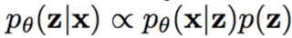
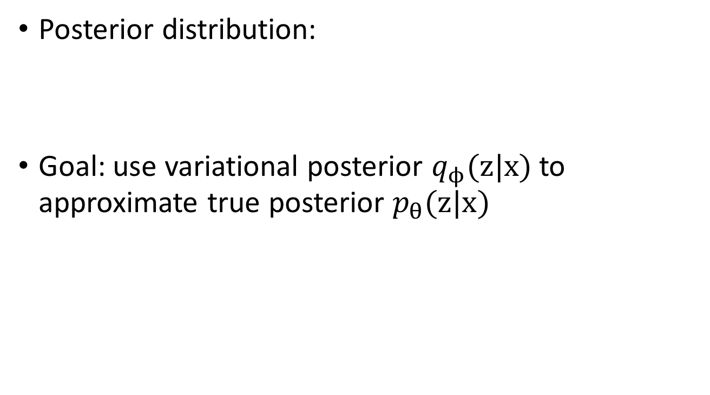
Theory: Variational Inference
Posterior distribution:
Goal: use variational posterior $q_{ϕ}(z|x)$ to approximate true posterior $p_{θ}(z|x)$
Intractable posterior!

Slide 8
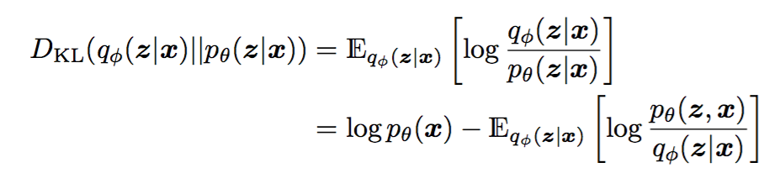
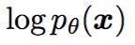
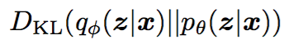
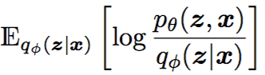
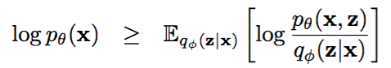
Theory: Variational Inference
Minimize KL-divergence between the variational posterior and true posterior
Finding 1: is constant
Minimizing = maximizing
Finding 2: KL-divergence is non-negative
Variational lower bound of data likelihood

Slide 9
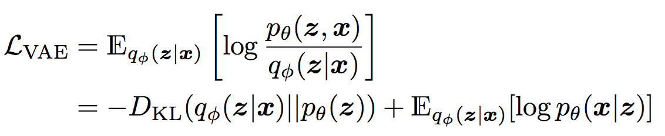
Variational Lower Bound of data likelihood
Regularization term
Reconstruction term

Slide 10
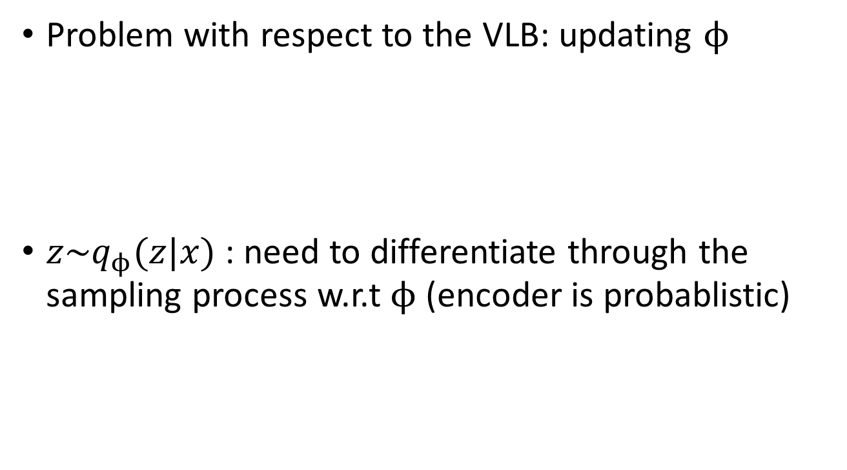
The Reparameterization Trick
Problem with respect to the VLB: updating $ϕ$
$z\sim q_{ϕ}(z|x)$ : need to differentiate through the sampling process w.r.t $ϕ$ (encoder is probablistic)

Slide 11
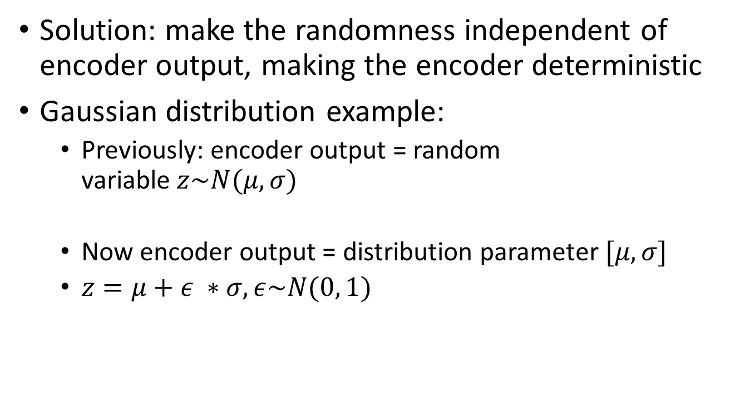
The Reparameterization Trick
Solution: make the randomness independent of encoder output, making the encoder deterministic
Gaussian distribution example:
Previously: encoder output = random variable$z\sim N(μ, σ)$
Now encoder output = distribution parameter $[μ, σ]$
$z=μ+ε ∗σ, ε\sim N(0, 1)$

Slide 12
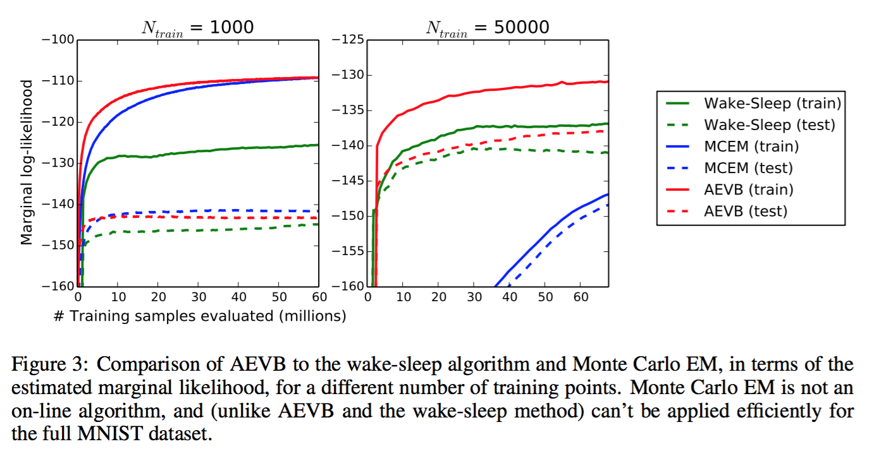
Result

Slide 13
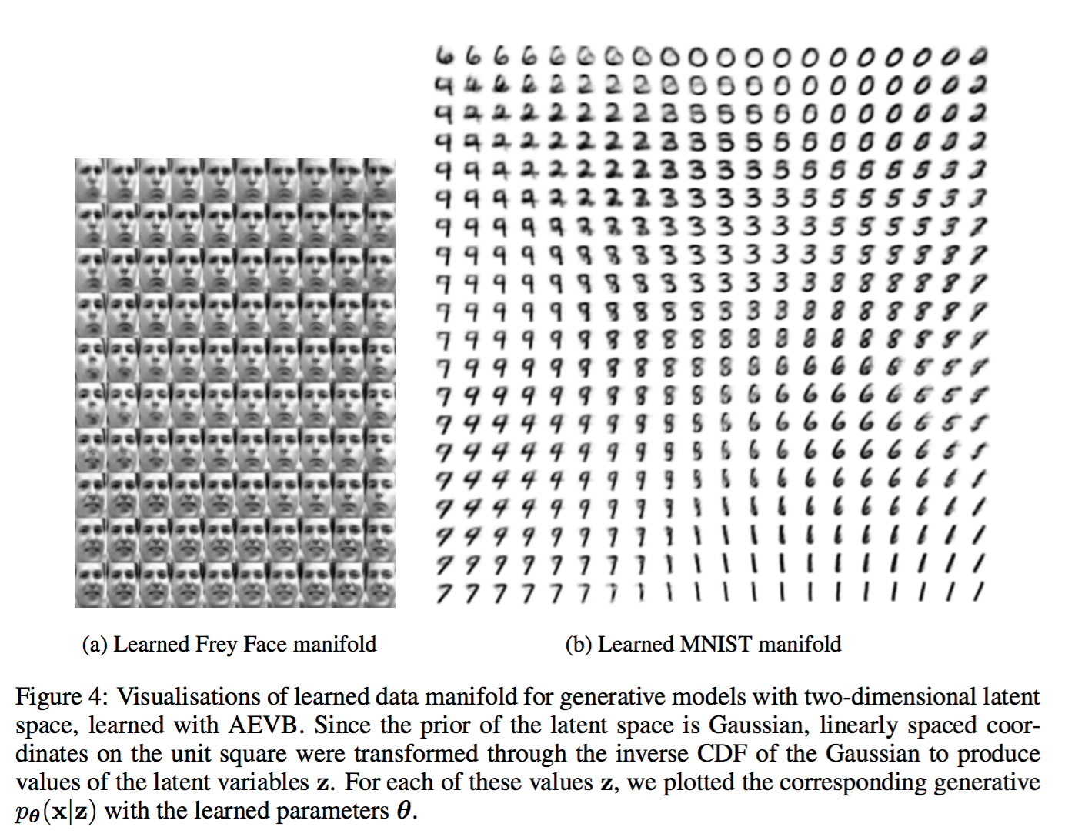
Result

Slide 14
Importance Weighted Autoencoders
Importance Weighted Autoencoders, Yuri Burda, Roger Grosse & Ruslan Salakhutdinov, ICLR 2016

Slide 15
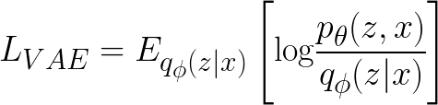
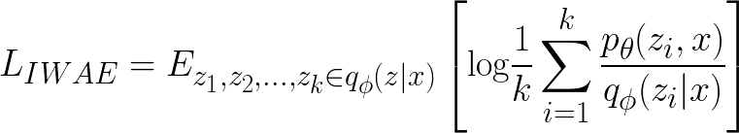
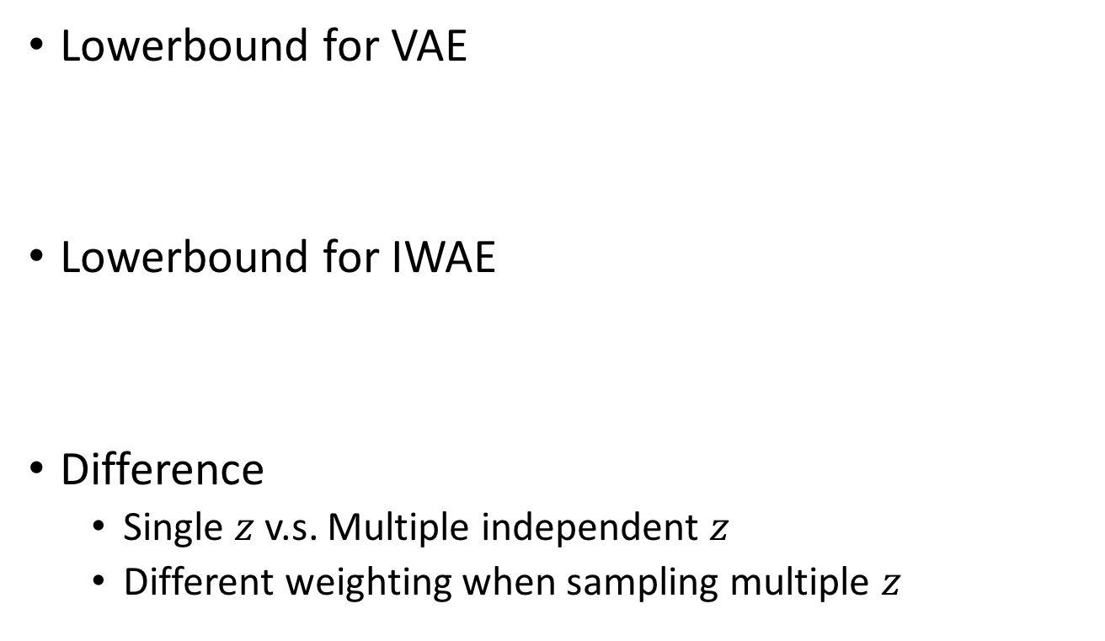
Different Lower bound
Lowerbound for VAE
Lowerbound for IWAE
Difference
Single $z$v.s. Multiple independent $z$
Different weighting when sampling multiple $z$

Slide 16
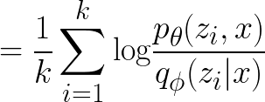
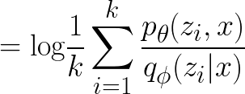
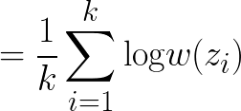
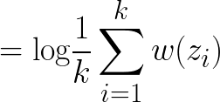
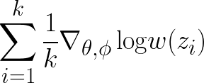
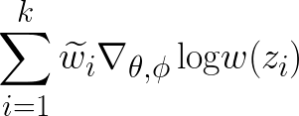
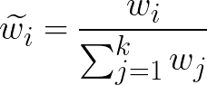
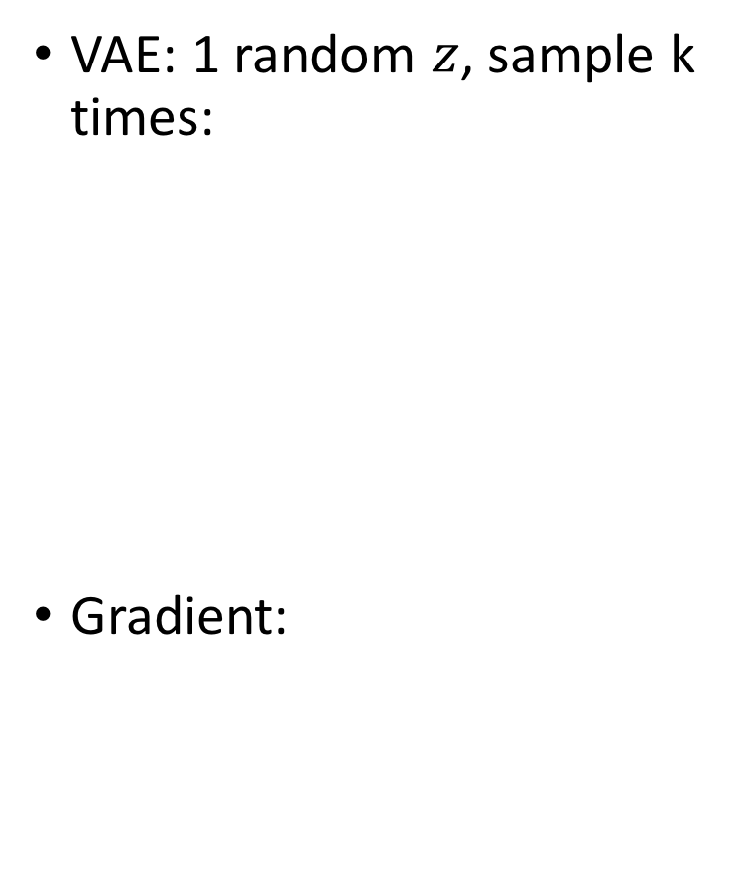
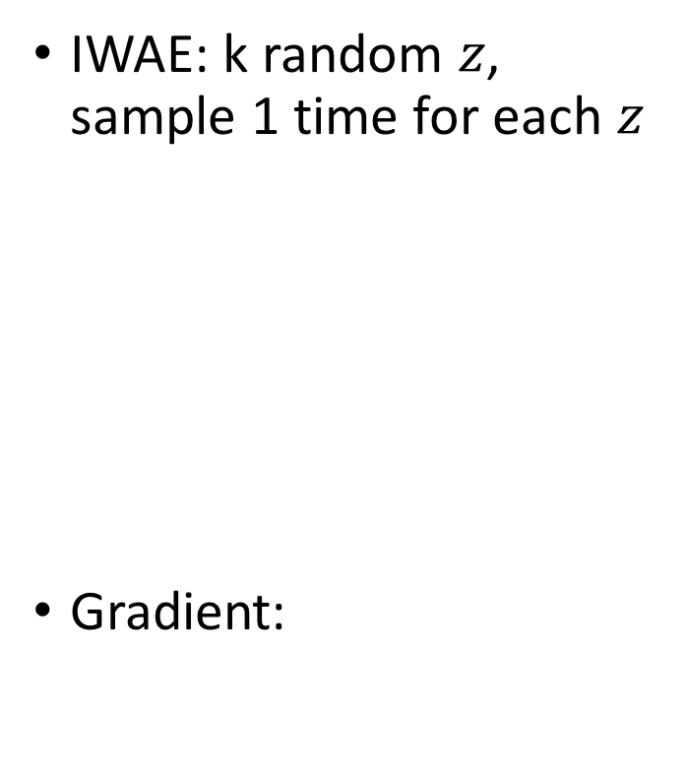
Sampling difference
VAE: 1 random $z$, sample k times:
Gradient:
IWAE: k random $z$, sample 1 time for each $z$
Gradient:

Slide 17
Sampling difference
VAE gradient
IWAE gradient
Monte Carlo sampling
Importance weighted sampling

Slide 18
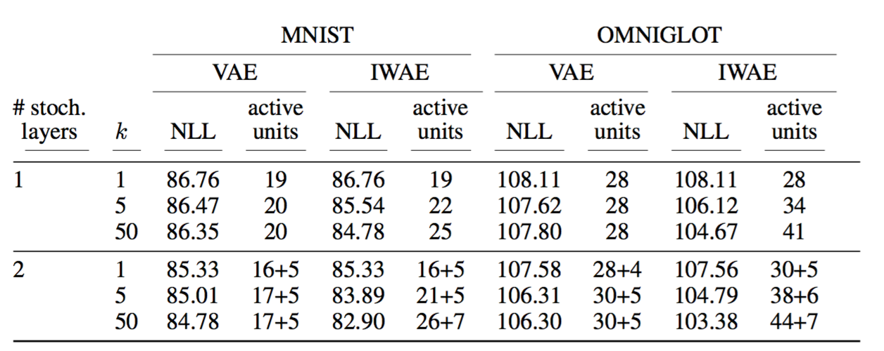
Result

Slide 19
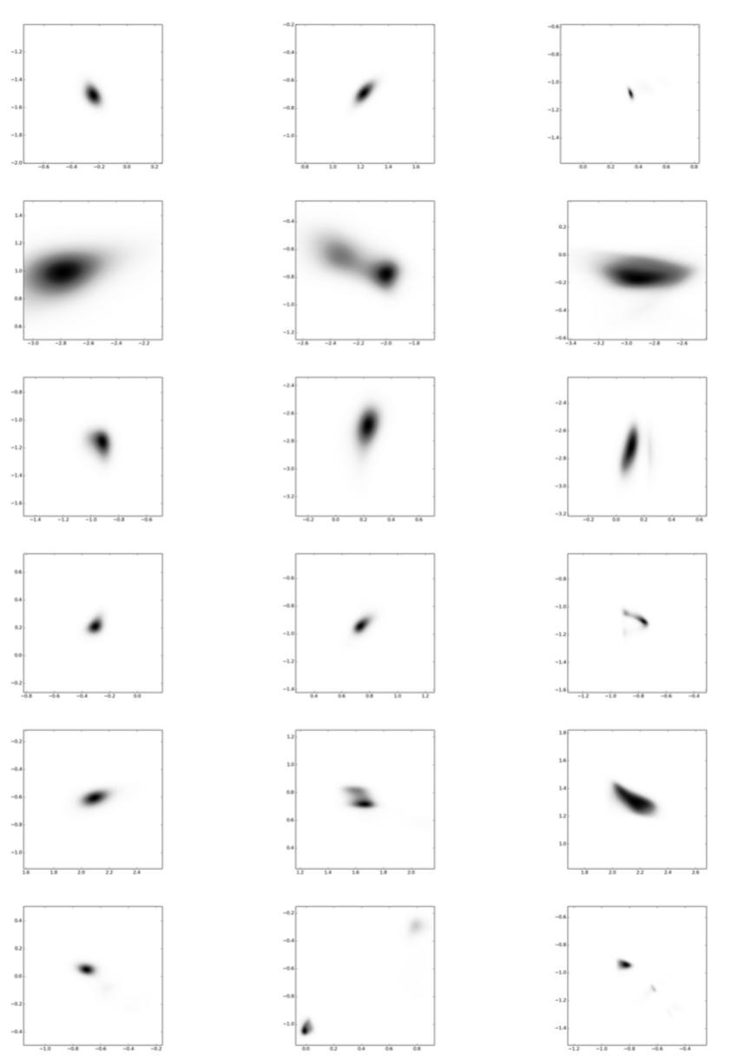
Posterior heatmap
VAE
IWAE, k=5
IWAE, k=50

Slide 20
Denoising Variational Autoencoders
Denoising Criterion for Variational Auto-encoding Framework, Daniel Jiwoong Im, Sungjin Ahn, Roland Memisevic, Yoshua Bengio, http://arxiv.org/abs/1511.06406

Slide 21
Denoising for Variational Autoencoders?
Variational autoencoder: uncertainty in the hidden layer
Denoising autoencoder: noise in the input layer
Combination?

Slide 22
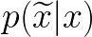
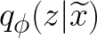
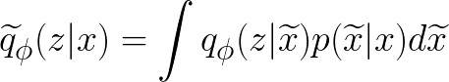
Posterior for Denoising VAE
Image corruption distribution (adding noise):
Original variational posterior distribution (encoder network):
Variational posterior distribution for denoising:

Slide 23
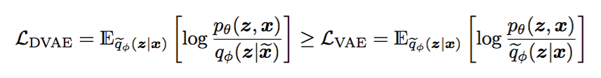
Posterior for Denoising VAE
: Gaussian
: Mixture of Gaussian

Slide 24
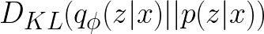
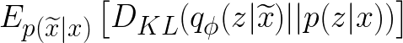
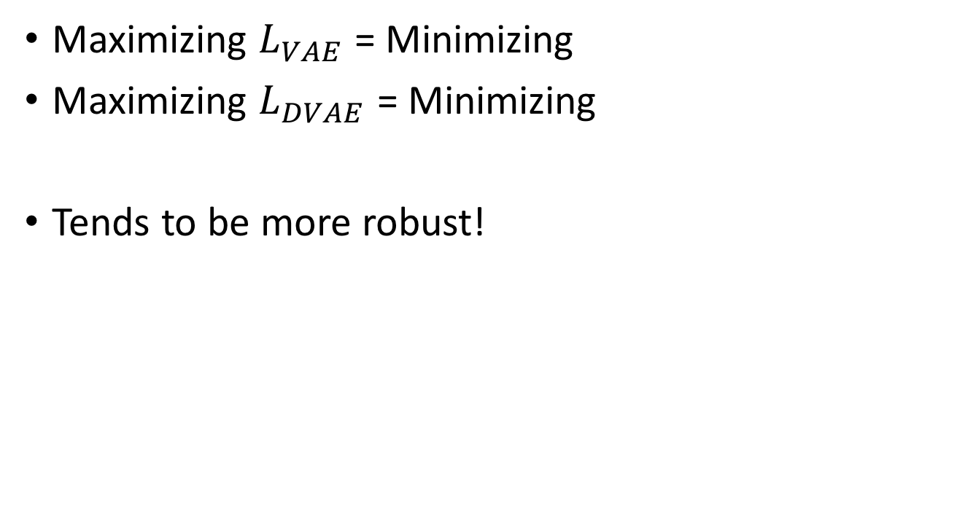
What does this lowerbound even mean?
Maximizing $L_{VAE}$ = Minimizing
Maximizing $L_{DVAE}$ = Minimizing
Tends to be more robust!

Slide 25
Training procedure
1. Add noise to the input, then send to the network
2. That is it. No difference for anything else
Can be used for both VAE and IWAE.

Slide 26
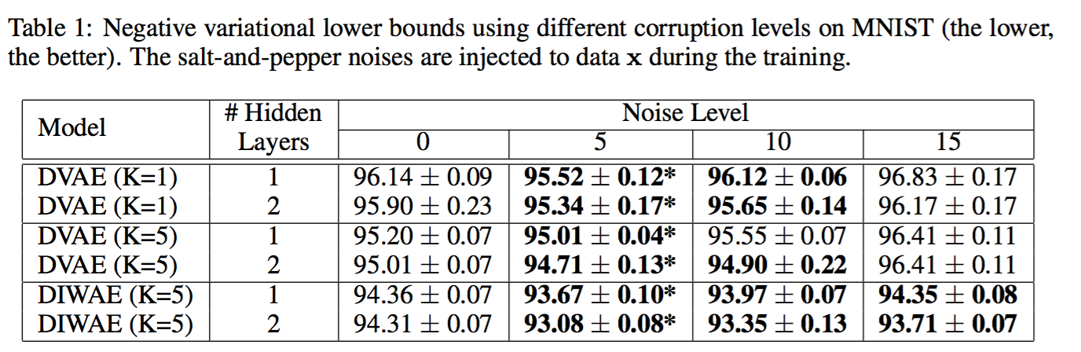
Test result

Slide 27
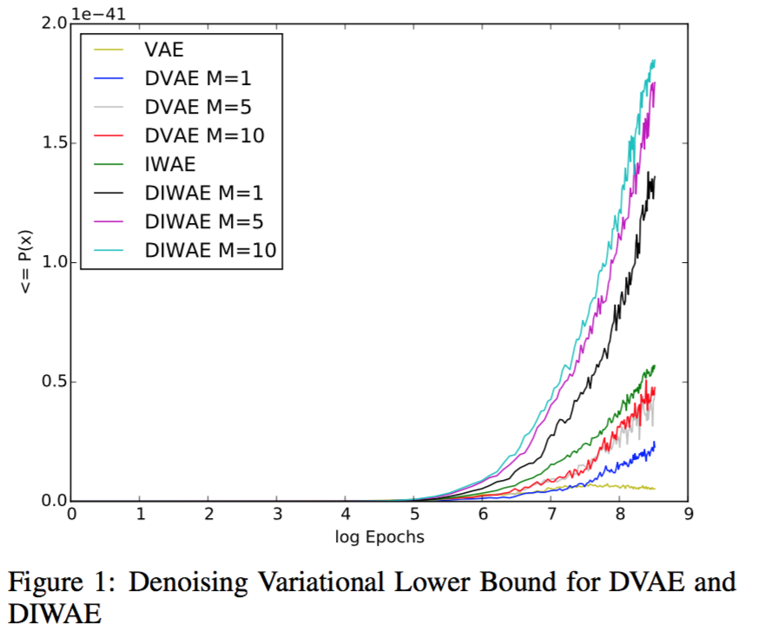
Test result

Slide 28
Deep Convolutional Inverse Graphics Network
Tejas D. Kulkarni , Will Whitney , Pushmeet Kohli , Joshua B. Tenenbaum
NIPS 2015

Slide 29
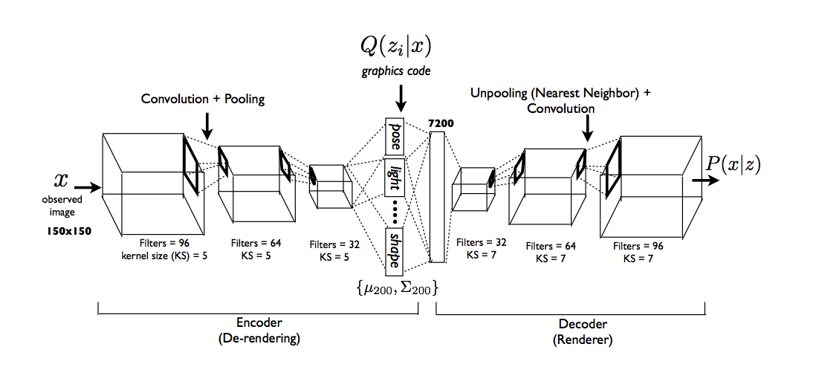
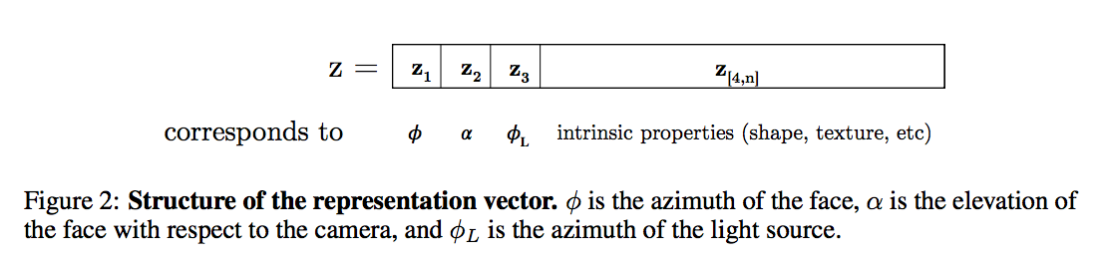
Hidden Layer = Transformation attributes

Slide 30
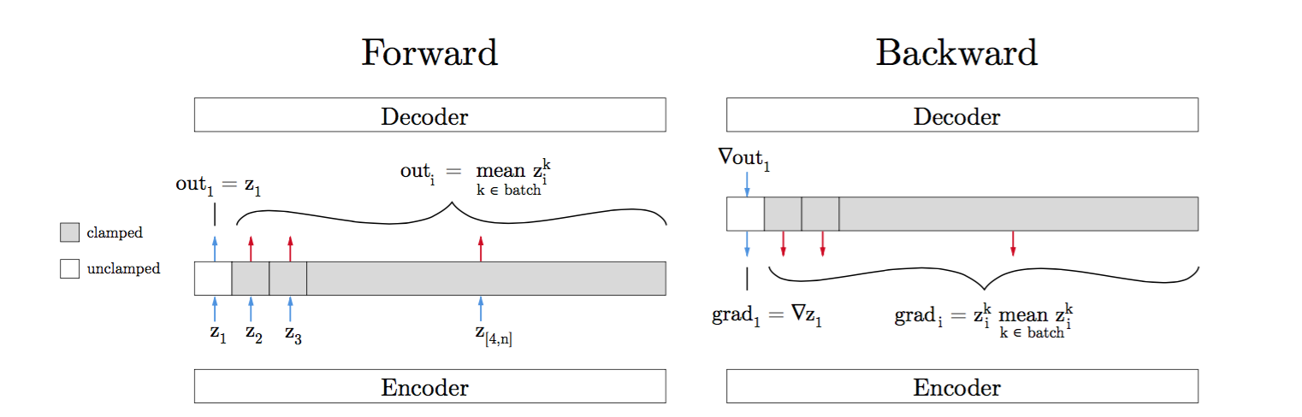
Transformation specific training

Slide 31
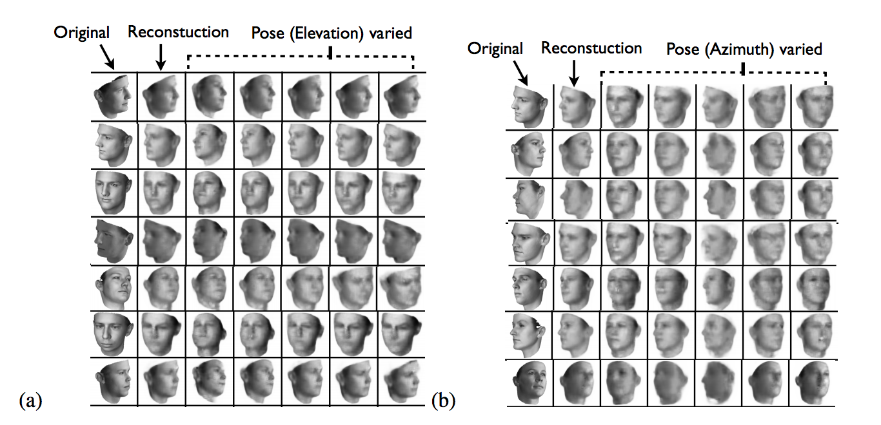
Manipulating Image = Changing Hidden Layer Value

Slide 32
DRAW: A Recurrent Neural Network For Image Generation
Karol Gregor, Ivo Danihelka, Alex Graves, Danilo Jimenez Rezende, Daan Wierstra
ICML 2015

Slide 33
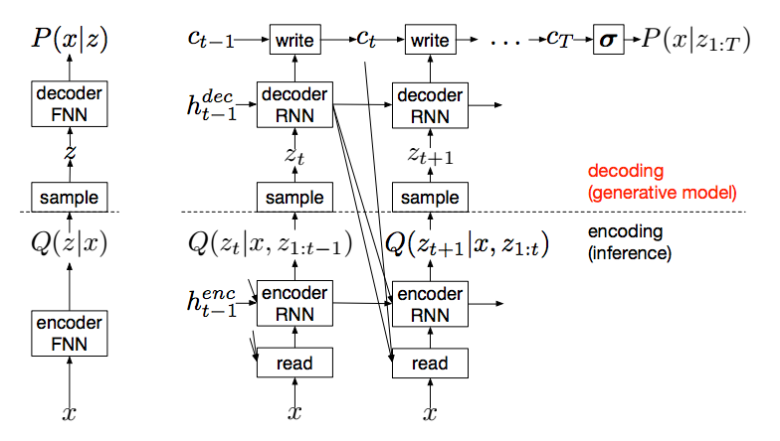
Variational Recurrent Network

Slide 34

Example

Slide 35
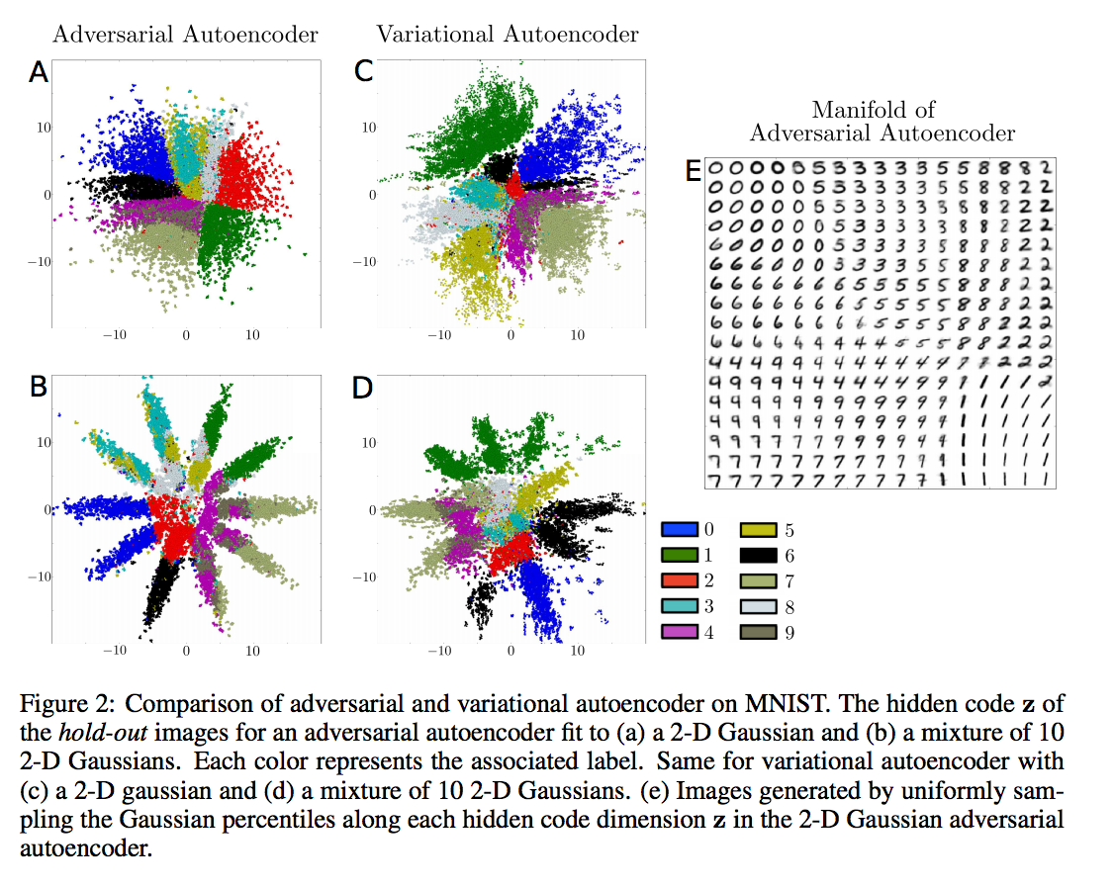
Further reading
Adversarial Autoencoders
A. Makhzani, et al., ICLR 2016
Adversarial learning for better posterior representation

Slide 36
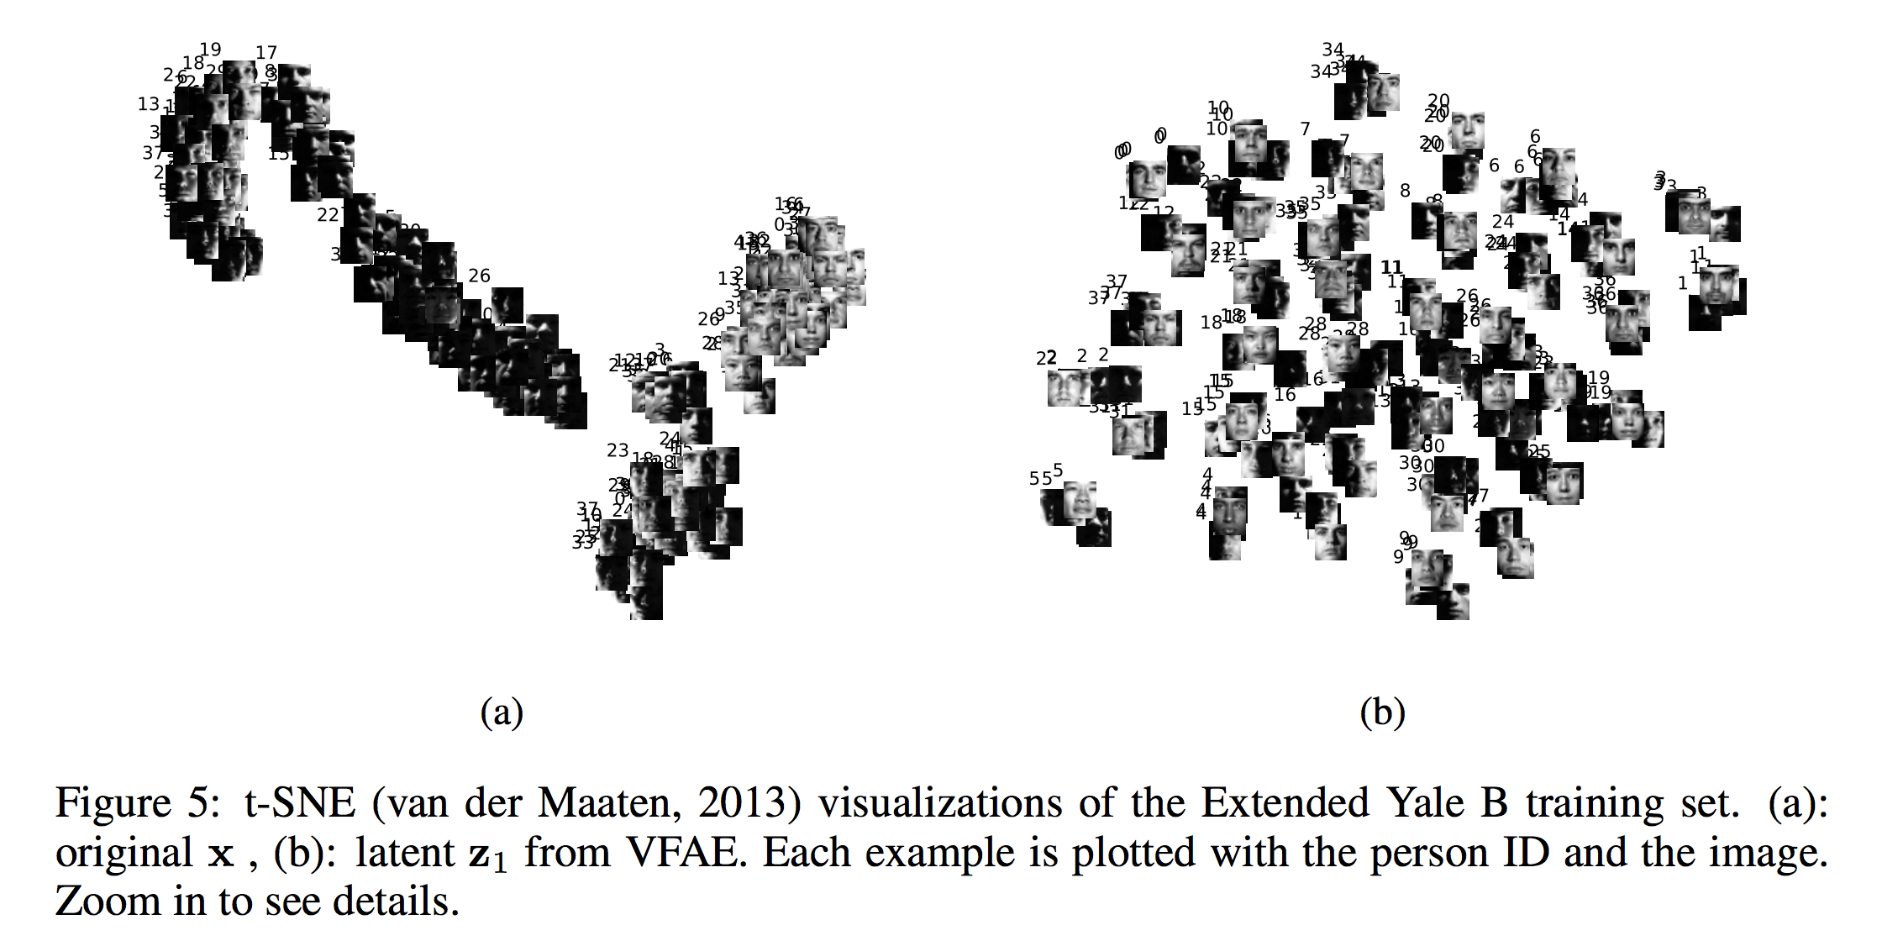
Further reading
The Variational Fair Autoencoder
Christos Louizos, et al., ICLR 2016
Remove unwanted sources of variation from data

Slide 37
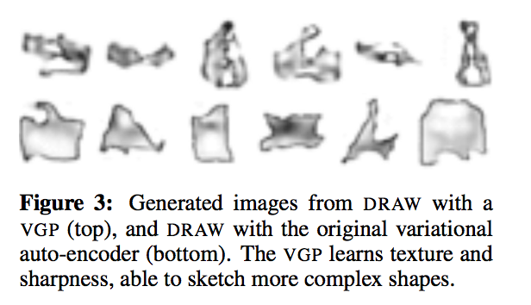
Further reading
The Variational Gaussian Process
Dustin Tran, et al, ICLR 2016
Generalization of the variational inference for deep network
Model highly complex posterior

